Slide 1
Preparing for Urgent Open Heart Surgery
Student’s Name
Institution

Slide 2
Outline
    Test Questions
    Introduction
    -Highlight what case study is about
    -Identify the type of open heart surgery in the case
    Case Report
    -Introduce case
    -Cardiopulmonary bypass operation
    Discussion
    -Procedure/Preparation for open heart surgery
    Conclusion

Slide 3
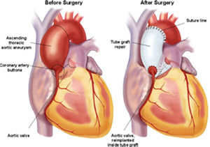
Test Questions
Multiple Choice
      How long does a typical surgery take
      4-5 hours (b) Less than 4 hours (c) More than 6 hours
      Which of following is not a function of the heart
      Pumps blood to the body
      Prevents blood from leaking
      Brings air from the atmosphere to the bloodstream
      What should one do during preparation for open heart surgery
      Eat evening meal as usual
      Not take any meal after midnight
      All of the above
Notes:
The above are the key test questions from the case study.

Slide 4
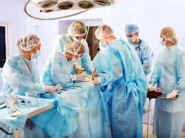
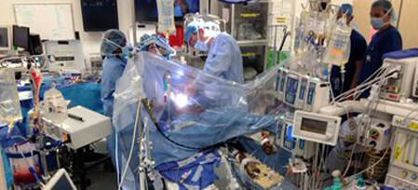
Continuation of Test Questions
True/False
    It is important to stop smoking before going for an open heart surgery (True or False)
Short Answer
    Why is it important to run tests before an open heart surgery?

Slide 5
Introduction
The case examined is “Coronary bypass surgery in 105-year-old patient with cardiopulmonary bypass.”
The case is about coronary artery bypass grafting
The case analyzed studies conducted on octogenarians
Notes:
This presentation shows a case of open heart surgery on a patient over 100-years old. Even though this kind of operation is rare, the case has shown, through analysis of octogenarian studies, how coronary artery bypass grafting can be done successfully with minimal complications in patients above 100 years of age.

Slide 6

Type of Open Heart Surgery
This surgery is coronary artery bypass graft surgery/Cardiopulmonary bypass
It seeks to restore the blood supply to the heart muscles
Key symptoms include
      Chest pain
      Fatigue or severe tiredness
      Abnormal heart rhythms
      Shortness of breath
Notes:
This case stud examines coronary artery bypass graft surgery. The function of performing this surgery is to improve or restore blood supply to the heart muscles. The primary symptoms highlighted from the case study report include chest pain, severe tiredness, abnormal heart rhythm, and shortness of breath. All these symptoms were identified on the patient presented in the case study.

Slide 7
Case Report
It involved a 105-year old male patient
He had known cardiac disease for more than 5 years
Ejection fraction was noted to be 45% in echocardiography
95% of stenosis in his left anterior descending
Semi urgent coronary artery bypass graft surgery was performed
Notes:
The patient involved in the surgery case was a 105-year old male with a history of cardiac disease. He has suffered from the cardiac condition for more than five years. The observation noted that his ejection fraction was at 45% while stenosis of his left anterior descending was at 95%. Therefore, the surgeons decided to go for a semi-urgent coronary artery bypass graft (CABG).

Slide 8
Cardiopulmonary bypass operation
Performed on the right axillary artery
Also, right atrial standard
Temperature cooled down to 28 degrees Celsius
Distal anastomoses performed on LAD and RCA posterior descending
Each anastomosis lasted for 3 minutes
And temperature retained
Notes:
As the case report showed, open heart surgery involved performing a cardiopulmonary bypass operation on the patient. The surgeons begun with the right axillary artery and right atrial standard. This required that the patient’s temperature be reduced to 28 degrees Celsius. After which, a distal anastomoses was performed on both LAD and RCA posterior descending at an interval of 3 minutes each. This required that the temperature be retained at 28 degrees Celsius.

Slide 9
Discussion: Preparing for Surgery
Preparation starts a day before
The patient should follow certain guidelines
This will help reduce potential complications
It ranges from the food to stopping certain risk habits
Therefore, operating room nurses contribute significantly
Notes:
Open heart surgery is one of the deadliest and challenging operations in the medical field. However, with proper preparation, which involves ensuring that the patient follows the right guidelines, the operation can go smoothly and successfully. The surgery begins a day before the actual operation’s day with the patient following the directives that can minimize the risk during and post-operation.

Slide 10
Before Surgery
Begins a night before the day of operation
Patient should eat their regular evening meals
But, should not take anything after midnight
This can include food or drink
Also, stop smoking (for smokers)
May be difficult to maintain
With proper guidance, it is possible
Notes:
Preparations begins a day before the surgery with the patient ensuring that the surgery would be successful and risk-free. This includes taking some precautions like stopping habitual behaviors that may expose them to risks, such as smoking for those smoking. Also, one is not supposed to take any meal or drink past midnight.

Slide 11
Day of Surgery
Taken through pre-operation test/physical examination
Monitor the blood pressure and crepitation
Take blood analysis
Check the patient’s symptoms and elevation
This will determine if they are suitable for PTCA
Notes:
From the case, the operation day is very important and the doctors must undertake some tests and procedures before taking the patient to an operation room. This includes physical examination and blood analysis. Also, the doctor must monitor the patient’s blood pressure and crepitation. Checking patient’s symptoms and elevation of the anterior derivation will help determine if the patient is fit or suitable for PTCA.

Slide 12
Continuation of Preparation
Ensure the patient’s temperature is appropriate
In the case, the appropriate temperature was 28 degrees Celsius
Adjust the nonpulsatile flow rate to 2.4L/min/m2 for patients over 100 years
Arterial blood pressure monitored
Mean arterial pressure maintained
Notes:
The preparation during the operation (before the surgeon starts the surgery process) begins with ensuring that the patient is fit for the surgery. The process involves regulating body temperature (in the case it was at 28 degrees Celsius). Also, the nonpulsatile flow rate is also adjusted (in the case it was adjusted to 2.4L/min/m2). This helps to maintain the arterial blood pressure. Mean arterial pressure must also be maintained (as in the case, it was 20-25 mmHg).

Slide 13
Conclusion
Every surgery is unique
It depends with the age and risk exposure of the patient
Based on this presentation:
    Several modifications are needed for open heart surgical procedure
    CABG surgery is risky due to the age of the patient
    Pre-operation examination can help in decision-making
Notes:
Open heart surgery on old patients, especially those over 100 years old can be risky and dangerous. However, this case has presented a successful CABG operation on patients over 100 years old. It shows that such operation is possible, when the right and all the preparations are taken seriously and adhered to.

Slide 14
Reference
Ogus, T. N., Erdim, F., Selimoglu, O., Tekiner, F., & Ugurlucan, M. (2010). Coronary bypass surgery in a 105-year-old patient with cardiopulmonary bypass. Case reports in medicine, 2010. Retrieved from https://www.hindawi.com/journals/crim/2010/725173/

